Slide 1


Slide 2
OFICINA DE RELACIONES INTERNACIONALES

Slide 3

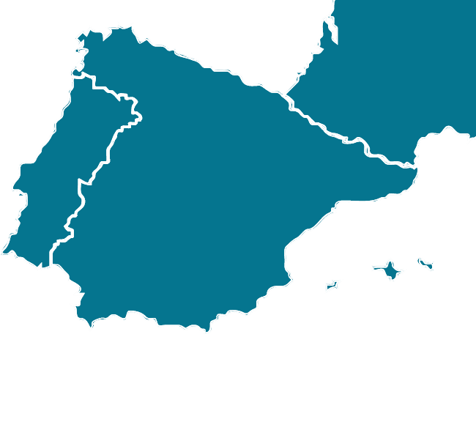
Where is Córdoba?
SPAIN
BARCELONA
MADRID
EUROPE
CÓRDOBA
Sevilla
Málaga
SPAIN
Notes:
The province of Córdoba is one of the eight provinces that make up the region of Andalusia, in the South of Spain. The capital of the province is Córdoba, the third largest city in Andalusia with more than 300.000 inhabitants.
One of the things to be highlighted is that Córdoba is a hub of high speed train communications: we are 45 minutes far from Seville, 55 minutes far from Málaga, 1 hour 40 minutes far from Madrid. These are the closest airports as well.
As a result of all that, Córdoba is easily reachable by plane and train (as if it were a big city) but at the same time, the standard of living is much more convenient than in a big city. I would say it is really a comfortable city to spend a year or a semester as an incoming international student.

Slide 4
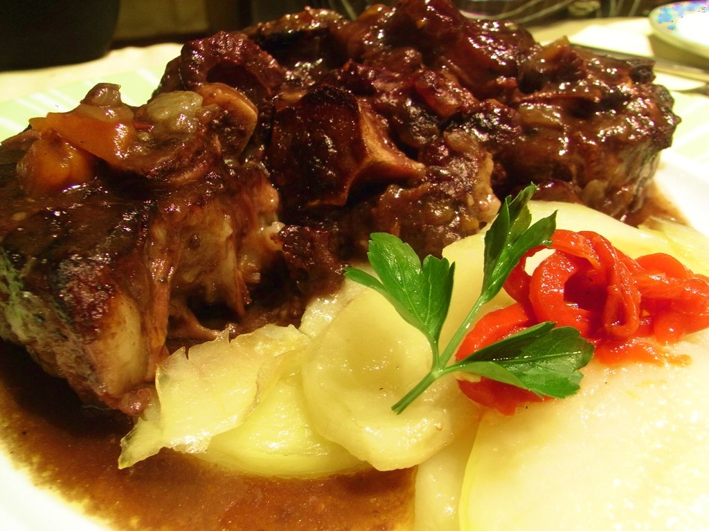
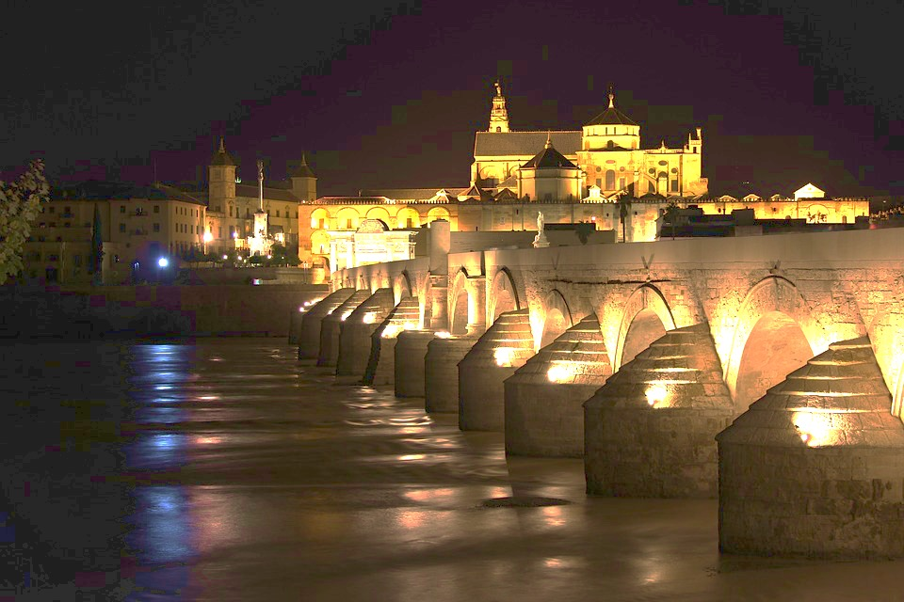

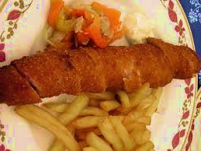
Enjoy Córdoba
GASTRONOMY & TOURISM
Rabo de Toro
Puente Romano
Salmorejo Cordobés
Mezquita de Córdoba
Flamenquín Cordobés
Medina Azahara
…etc
FLAMENCO
Notes:
Here there are some historical world-wide known buildings you’ve already seen during the video and some typical dishes you really should taste if you come to Córdoba

Slide 5
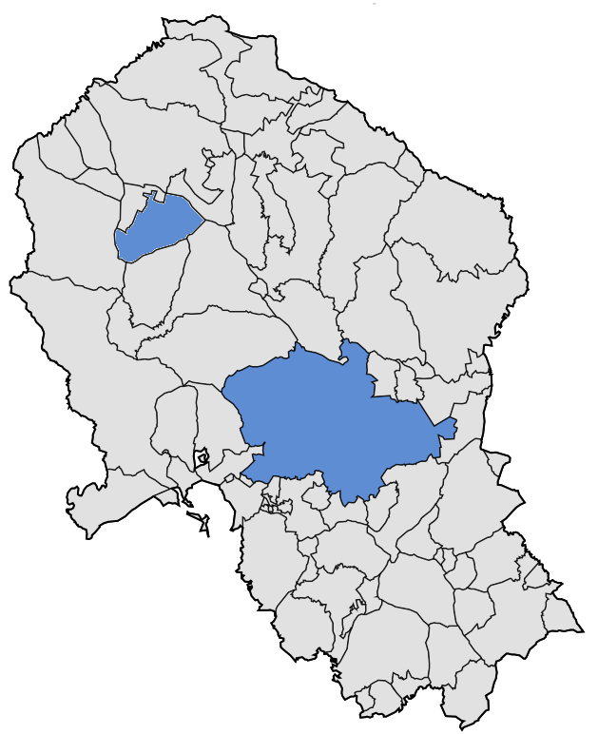
Facts
300.000 INHABITANTS
FOUNDED IN 1972
10 FACULTIES
17.000 STUDENTS
1250 INTERNATIONAL STUDENTS
1,500 ACADEMIC STAFF
1,200 OFFICERS AND TECHNICIANS
Notes:
I usually say that University of Córdoba is the University of the Province of Córdoba, but not a provincial University.
We are the University of our Province because the majority of young people from Cordoba that want to enroll in higher education choose our University to study in. And this makes our relations with public institutions and private companies from the whole territory very unique and strong.
But we are not a provincial University because we are heir to a centuries-old historical and cultural legacy, a broad intercultural outlook and an open worldview.
Ours, commonly referred to by UCO is a medium-size University if we talk in terms of numbers. We have around 17.000 students, considering undergraduate and postgraduate. Approximately 6-7% of them are international students, either exchange students or degree seekers.
All of UCO’s facilities are located in the capital except the Higher Polytechnic School in Belmez, in the north of the province.

Slide 6
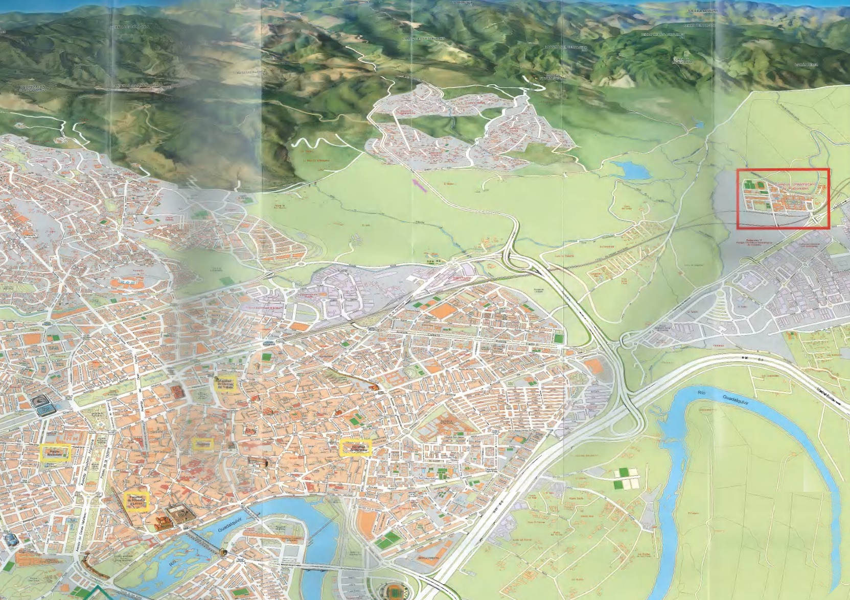
City & Campuses
CAMPUS DE
RABANALES
RECTORATE
HUMANITIES, LEGAL
AND SOCIAL
SCIENCES CAMPUS
HEALTH
SCIENCES CAMPUS

Slide 7
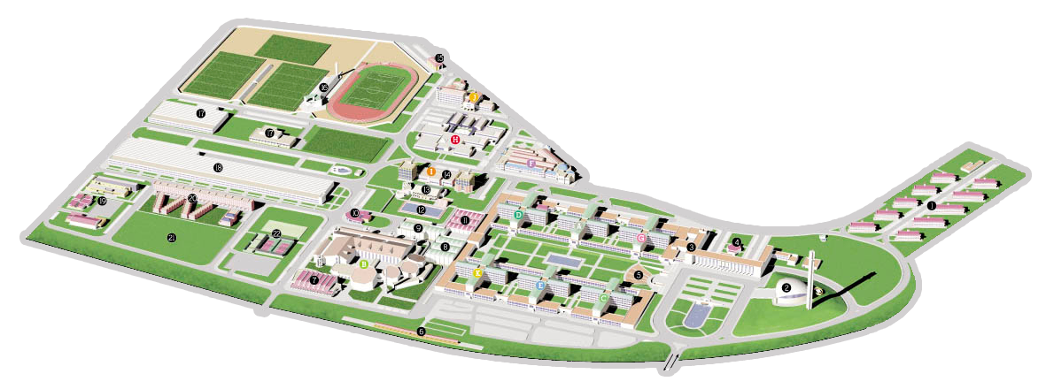
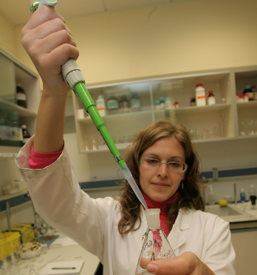
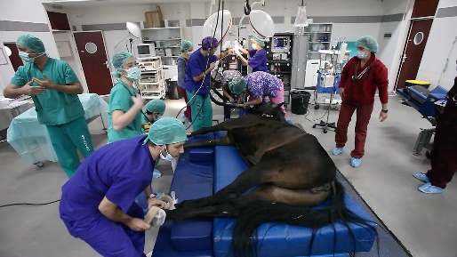
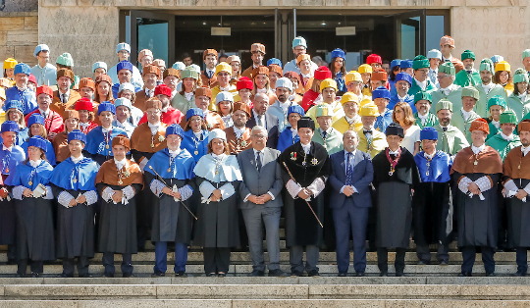
Campus de Rabanales
Notes:
1) Rabanales campus: Food and Agriculture, Science and Technology
Rabanales Campus is located 8 km outside the city of Córdoba, and has modern facilities with the latest and brand new technology. The campus is connected to the city centre by train (journey times of five minutes), a bus route and cycle lane.
Apart from the departmental buildings, other notable buildings include the lecture theater, the veterinary hostpital and the Assembly Hall
To be mentioned as well: central Library, modern sport facilities, a dormitory, an Experimental Farm, among others.

Slide 8
Agrifood, Science & Tech
AGRI. & FOREST ENG.
  Rural and Agrifood Eng.
  Forest Eng.
  Oenology
  Joint D.
SCIENCES
  Environmental Sci.
  Biochemistry
  Chemistry
  Biology
  Physics
ENG. SCIENCES
  Ind. Electronic Eng.
  Mechanical Eng.
  Computer Eng.
  Electrical Eng.
VETERINARY
  Food Science & Technology
  Vet. Medicine
ENG. SCIENCES IN BELMEZ
  Civil Engineering
  Mining and Energy R.
  Joint D.
Notes:
The Colleges and Schools located at Rabanales are:
→Veterinary Medicine School;
→Sciences School;
→Agriculture and Forestry Engineering School;
→Higher Polytechnic School
Not to be forgotten is the Higher Polytechnic School in Belmez, located not at the Rabanales campus but in a small town in the north of the province, as mentioned before.

Slide 9
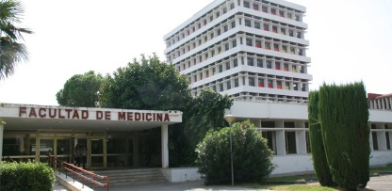
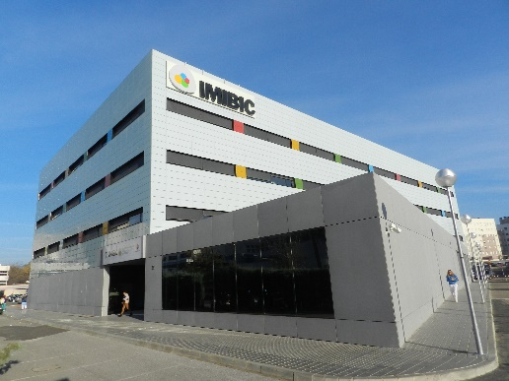
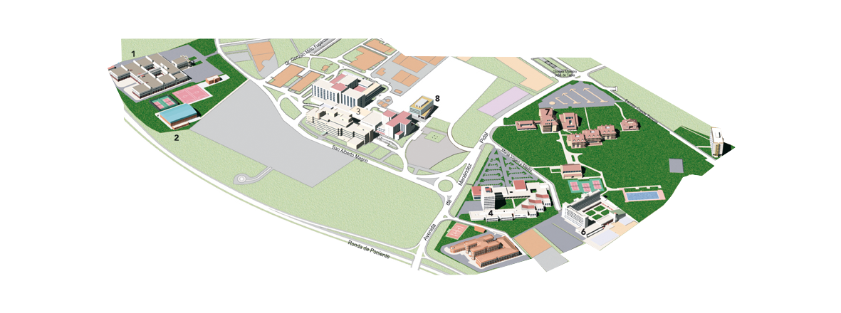
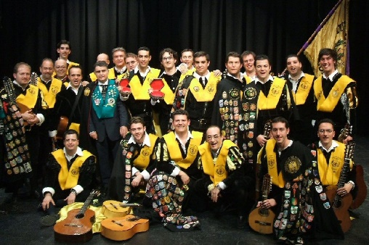

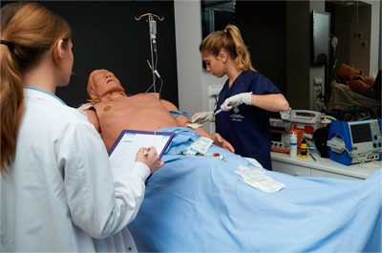
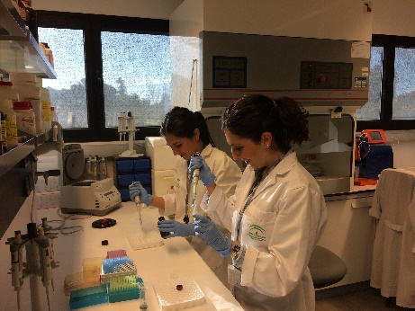
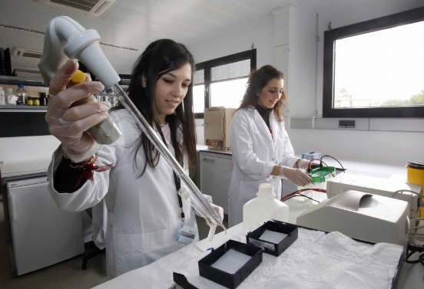
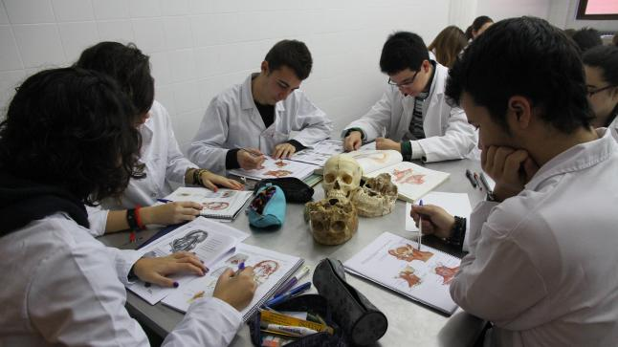
Health Sciences Campus
MEDICINE AND NURSING
  Medicine
  Nursing
  Physiotherapy
Notes:
2) Health Sciences Campus
This campus is located on the western side of the city, nearby the Reina Sofia University Hospital.
The hospital works closely with the Medicine and Nursing School, which is located nearby.
There it is also the IMIBIC to be found: one of the most prestigious research centre in Europe.
The Education School is also to be found in this western campus as well as sport facilities (a sports hall and tennis courts) and our main dormitory.

Slide 10
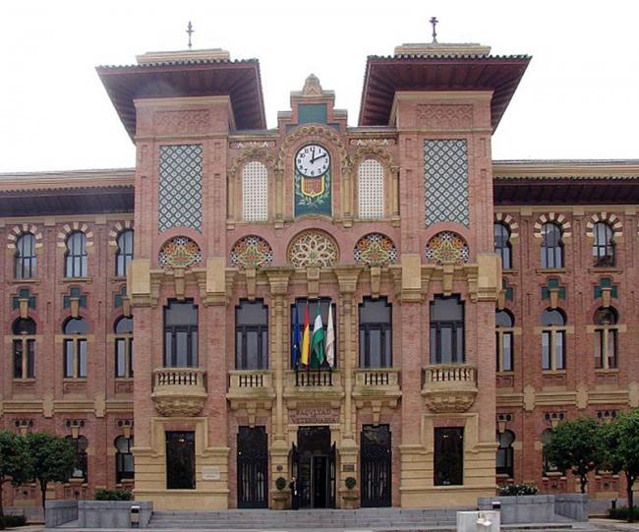
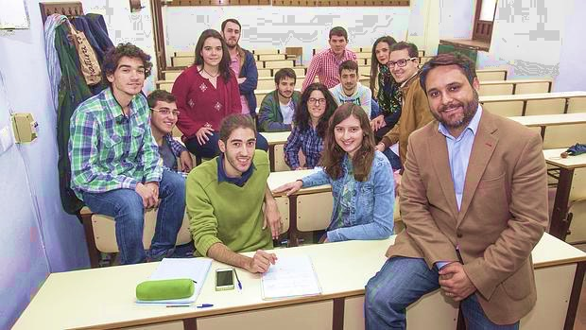
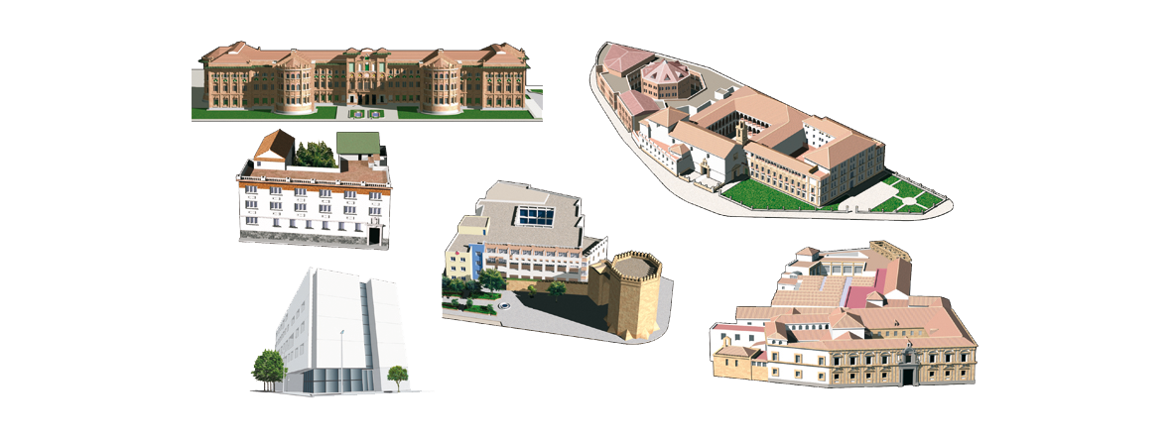
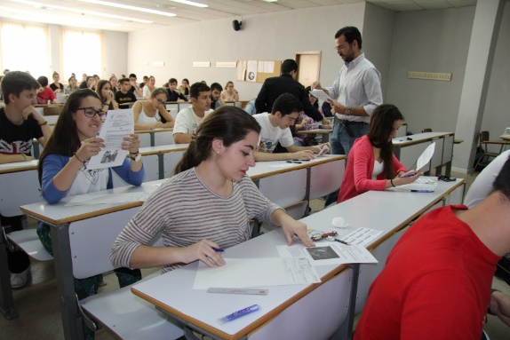
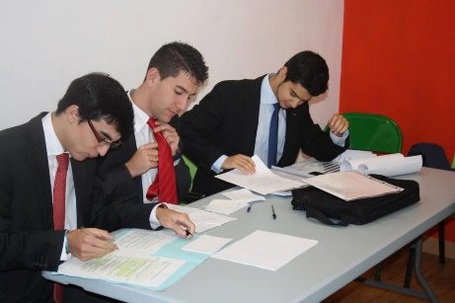
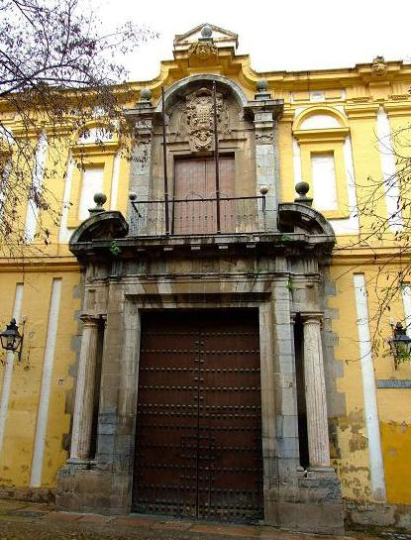
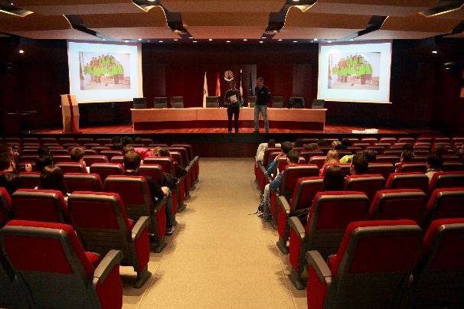
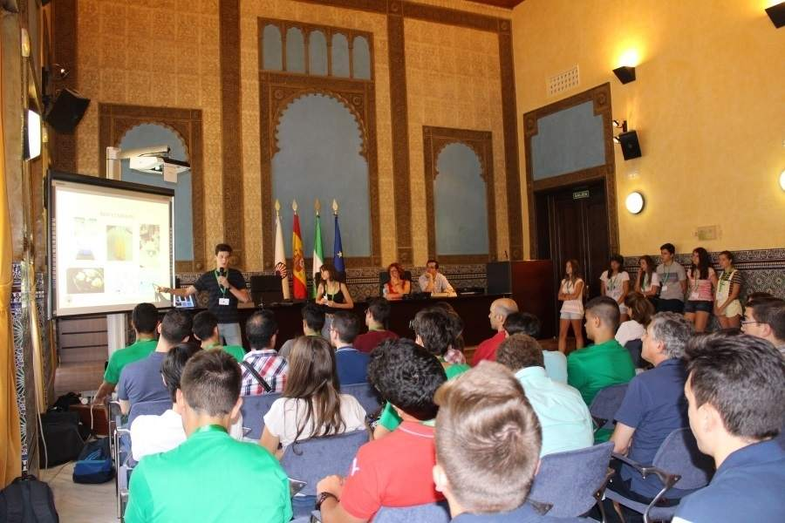
Humanities, Legal and Social Sciences Campus
Notes:
3) Downtown campus: Humanities, Law and Social Sciences; central services and mail building (Rectorate)
In the Downtown Campus you may find some of our most emblematic buildings,
such as the Humanities School, Labour Sciences School, the Law and Business School or the Rectorate.
→The Law and Business School is located in the former El Carmen Convent, which dates back to the seventeenth century. Its cloister is an historical monument considered a site of cultural interest to be preserved.
→Located in the Jewish quarter, the Humanities School occupies a building that is considered today one of the finest examples of eighteenth century civil architecture. It is home to the Chapel of San Bartolomé, one of the most visited monuments in Córdoba.
→Labour Sciences School
→The Rectorate is located in the former home of the Veterinary Medicine School, now hosts the central university services including, among others, the international Office. It is a so called neo Mudéjar style (or regionalist style) building that dates back to the thirties of the past century. Considered by art historians as one of the finest examples of the regionalist style, it is also one of the city’s most emblematic structures.

Slide 11



Human. & Legal and Social Sci.
PHILOSOPHY & LET.
  History
  Art History
  Translation and Int.
  Spanish Studies
  English Studies
  Cultural Manag.
  Joint. Degrees
EDUCATION SCIENCES
  Early Childhood Ed.
  Primary Education
  Social Education
LAW & BUSINESS AND ECONOMIC SCI.
  Business Admin. and Management
  Law
  Joint D.
LABOUR SCIENCES
  Labour Sci.
  Tourism
Notes:
These are their corresponding studies

Slide 12
English-taught Courses
F. OF LABOUR SCIENCES
  6 in D. Tourism
S. OF ENGINEERING SCI.
  5 in Computer Sci.
F. OF VETERINARY M.
  9 in Veterinary M.
  7 in Food Sci & T.
F. OF EDUCATION SCI.
  12 in Primary Ed.
  7 in Early Child. Ed.
S. AGRI. & FOREST ENG.
  15 in F. & Agrifood Eng.
F. OF SCIENCES
  9 in Biology
  6 in Biochemistry
  5 in Env. Sciences
  8 in Physics
  11 in Chemistry
F. OF LAW, B. & EC. SCI.
  7 in Law, B. Admin & M.
Notes:
Though most of the courses are provided in Spanish, the University is continuously eager to reach to a wider public and has been offering, and increasing, the number of courses taught in English. The aim is to make possible that students with lower Spanish competences come and fruitfully complement their curricula in our Institution.
Link: http://www.uco.es/internacional/extranjeros/nuestroscursos/documentos/EnglishCoursesUCO1718.pdf

Slide 13
Postgraduate programmes
MASTER PROGRAMMES
  23 in Eng. & Arch.
  4 in Arts & Human.
  12 in Social & Legal Sci.
  8 in Sciences
  5 in Health Sciences
UCO DOCTORAL PROGRAMMES
  Biomedicine
  Social and Legal Sci.
  Ad. Computing, Energies and Plasmas
  Electrochemistry, Sci. and Tech.
  Languages and Cultures
  Heritage
INT. DOC. SCHOOL IN AGRIFOOD
  Biosciences & Agri-food Sci.
  Biogeochemical Flow Dynamics and its App.
  Fine Chemistry
Notes:
Undergraduate studies are then supplemented with a rich and varied choice of post-graduated programmes with 52 masters, that help their holders to break into the job market, and 6 Doctoral programmes and 5 in the International Doctoral School in Agrifood, where the University enjoys a leading reputation. Worth of mention is that many of these Doctoral programmes have been honoured with the Excellence Award of the Spanish Ministry of Education, and the UCO is one of the few institutions covering some of these master degrees.

Slide 14
Research & Transfer
AMONG THE BEST UNIVERSITIES IN
* 199 RESEARCH GROUPS
* 7 MILLION € IN RESEARCH
* 5 MILLION € IN TRANSFER PROJECTS
* EXCELLENCE RESEARCH CENTRES
* 29 TECHNOLOGY-BASED ENTERPRISES
  Veterinary Sciences
  Food Science and Tech.
  Chemical Engineering
  Agronomic Sciences
  Energy and Eng. Sciences
  Env. Engineering & Sci.
  Computer Sciences
  Human Biology Eng. & Sci.
  Hydraulical Resources
Notes:
Ever since it was founded, our institution has been committed to research and innovation. With a budget close to 7 million € in research and 5 in transfer, the University:
is home to 199 research groups that continuously push up the knowledge frontier and currently instruct near 2,000 PhD-holders;
has participated in the creation of 29 technology-based entreprises and 111 patent applications;
leads the ceiA3 Agrifood Campus of International Excellence
and supports the Maimonides Institute for Biomedical Research and the University Institute of Research in Fine Chemistry and Nanotechnology
All this makes that the University is situated among the best Institutions according to renowned rankings such as the Shangai's Academic Ranking of World Universities or those of the Web of Science. Just as some examples, it is among the 100 best Universities in areas such as Veterinary Science, Food Science and Technology, Chemical Engineering, and Agronomy. Also, it is very well situated in other areas such as Computer Science and Human Biology Engineering and Sciences.

Slide 15
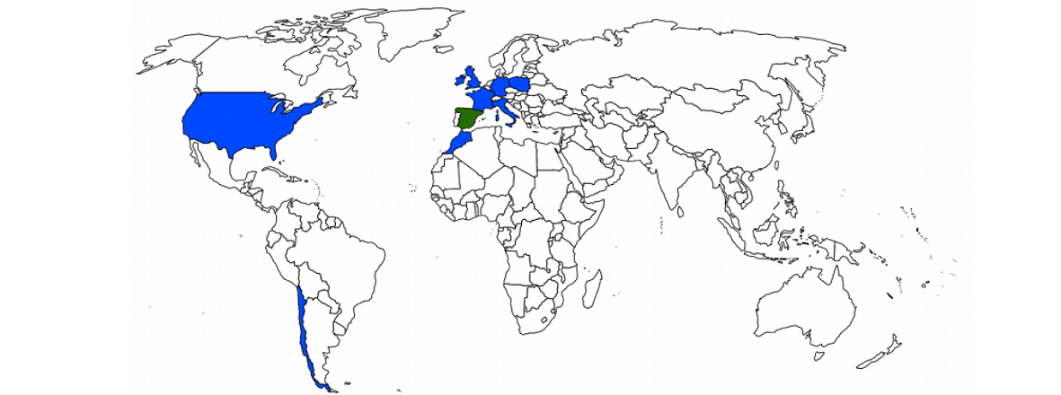
Internationalisation
DUAL GRADUATE PROGRAMS
Notes:
The UCO seeks to establish fruitful collaborations with Institutions all over the world. Currently, it offers dual academic programs with pretigious Universities such as the Virginia Commonwealth University of the United States, Cranfield Univ of the United Kingdom, the University Paris-Est Créteil of France, or the Bialistok Univesity of Technology, in Poland.

Slide 16
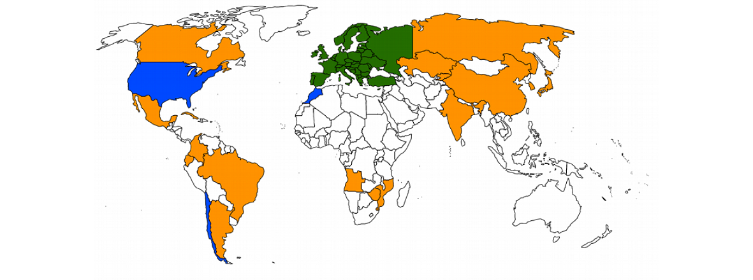
Internationalisation
MOBILITY AGREEMENTS
Notes:
Even more, our University participates in a bit more than 900 mobility agreements, most of them Erasmus+, that allow that near 1,500 students come and complement their curricula in our Institution

Slide 17

www.uco.es
ALBERTO DOMINGO BAZÁN – GABINETE DE COMUNICACIÓN
CARLOS GARCÍA MARTÍNEZ – OFICINA DE RELACIONES INTERNACIONALES
UNIVERSIDAD DE CÓRDOBA

